Slide 1


UNIVERSITY INSTITUTE OF ENGINEERING
COMPUTER SCIENCE ENGINEERING
Bachelor of Engineering (Computer Science & Engineering)
Subject Name: STATISTICAL METHODS USING R
Subject Code: 20SMT-460

Slide 2
Addition Theorem in Probability

Slide 3
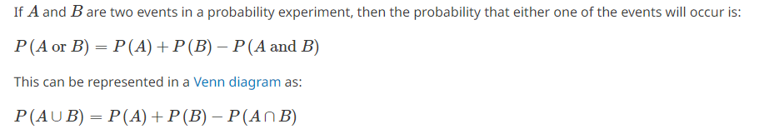
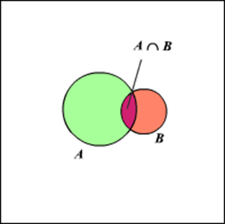

Slide 4
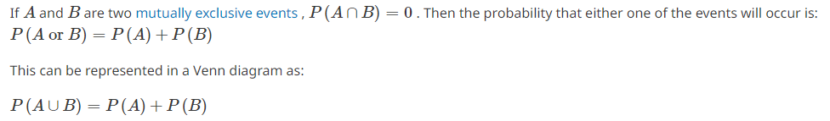
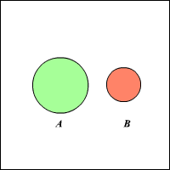

Slide 5
Examples
If you take out a single card from a regular pack of cards, what is probability that the card is either an ace or spade?

Slide 6
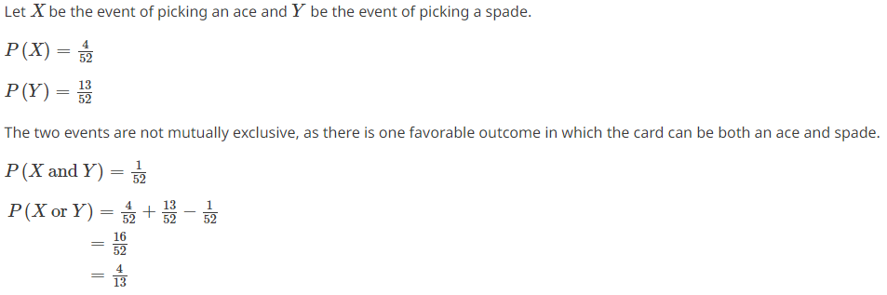
Solution:

Slide 7
Example:
Suppose an investor considers investing in two stocks, A and B. The probability of stock A increasing in value over the next year is 0.4, and the probability of stock B increasing in value over the next year is 0.6. The investor wants to know the probability that at least one of the two stocks will increase in value.
By using the addition rule of probability, we can calculate the probability as follows:
P(A or B) = P(A) + P(B) – P(A and B)
= 0.4 + 0.6 – (0.4 x 0.6)
= 0.76
So, there is a 76% probability that at least one of the two stocks will increase in value over the next year.

Slide 8
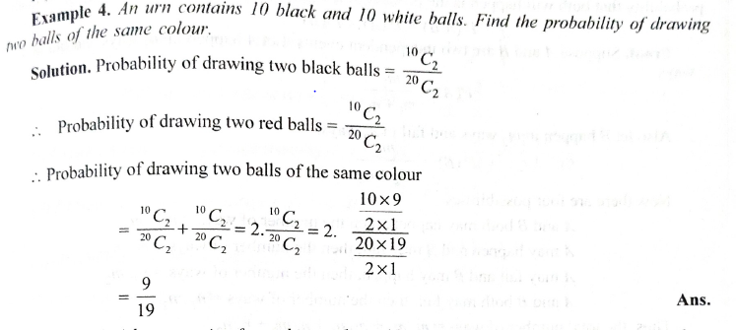

Slide 9
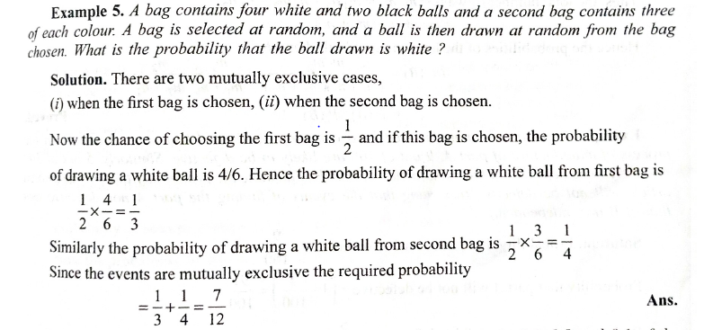

Slide 10

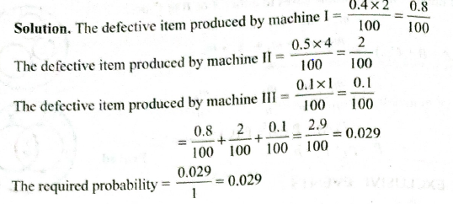

Slide 11
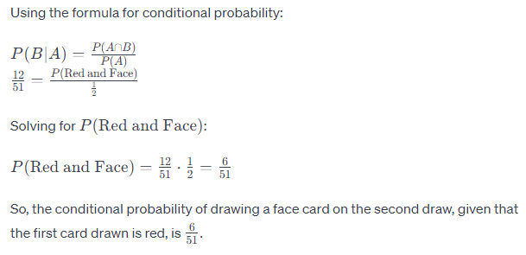
Conditional Probability:

Slide 12
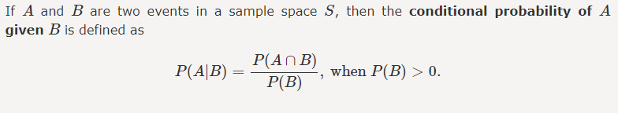
Conditional Probability:

Slide 13
Example 1: Two dies are thrown simultaneously, and the sum of the numbers obtained is found to be 7. What is the probability that the number 3 has appeared at least once?

Slide 14
Solution:
The sample space S would consist of all the numbers possible by the combination of two dies. Therefore S consists of 6 × 6, i.e. 36 events.
Event A indicates the combination in which 3 has appeared at least once.
Event B indicates the combination of the numbers which sum up to 7.
A = {(3, 1), (3, 2), (3, 3)(3, 4)(3, 5)(3, 6)(1, 3)(2, 3)(4, 3)(5, 3)(6, 3)}
B = {(1, 6)(2, 5)(3, 4)(4, 3)(5, 2)(6, 1)}
P(A) = 11/36
P(B) = 6/36
A ∩ B = 2
P(A ∩ B) = 2/36
Applying the conditional probability formula we get,
P(A|B) = P(A∩B)/P(B) = (2/36)/(6/36) = ⅓

Slide 15
Example 2: In a group of 100 computer buyers, 40 bought CPU, 30 purchased monitor, and 20 purchased CPU and monitors. If a computer buyer chose at random and bought a CPU, what is the probability they also bought a Monitor?

Slide 16
Solution:
As per the first event, 40 out of 100 bought CPU,
So, P(A) = 40% or 0.4
Now, according to the question, 20 buyers purchased both CPU and monitors. So, this is the intersection of the happening of two events. Hence,
P(A∩B) = 20% or 0.2
By the formula of conditional probability we know;
P(B|A) = P(A∩B)/P(B)
P(B|A) = 0.2/0.4 = 2/4 = ½ = 0.5
The probability that a buyer bought a monitor, given that they purchased a CPU, is 50%.

